Slide 1
HIRING PROCESS ANALYTICS
STATISTICS
Submitted by : Sruthi Suresh

Slide 2

CONTENTS
PROJECT DESCRIPTION
APPROACH
TECH-STACK USED & LINK
DATA CLEANING
DATA ANALYTICS TASKS - INSIGHTS
Hiring Analysis
Salary Analysis
Salary Distribution Analysis
Departmental Analysis
Position tier Analysis
CONCLUSION

Slide 3

PROJECT DESCRIPTION
The hiring process is a crucial function of any company, and understanding trends such as the number of rejections, interviews, job types, and vacancies can provide valuable insights for the hiring department.
The goal of this project is to use the knowledge of statistics and Excel to draw meaningful conclusions about the company's hiring process.
As a data analyst at a multinational company like Google, your task is to analyze the company's hiring process data and draw meaningful insights from it.
The insights gained could potentially help the company improve its hiring process and make better hiring decisions in the future.

Slide 4
APPROACH
Downloaded the Statistics Dataset provided
Understand the data present in the file
Cleaning and preparation of the data
Gaining insights out of the data using Excel

Slide 5

TECH-STACK USED
Microsoft Excel
LINK
Click here for the Excel File Link

Slide 6
DATA CLEANING
Handling Missing Data:
Offered Salary column has 1 record with blank value which has the corresponding Department column as “Sales Department” and Post Name column as “i7”. This was replaced by the value 45400 obtained as the median of Offered Salary for Sales Department and i7 Post Name.
Post Name column has 1 record with ‘-’ value which has the corresponding Department column as “Sales Department” and Offered Salary column as “85914”. This was replaced by the value c9 obtained as the most commonly occurring Post Name while considering Sales Department and Offered Salary in the range of 85000 to 86000.
There were 15 records having ‘-’ value in the event_name column. This was replaced by “Don’t want to say”.
Error Correction:
In the column Post Name, all the values given as “c-10” which could be possibly due to human error was replaced with c10 similar to other values.

Slide 7
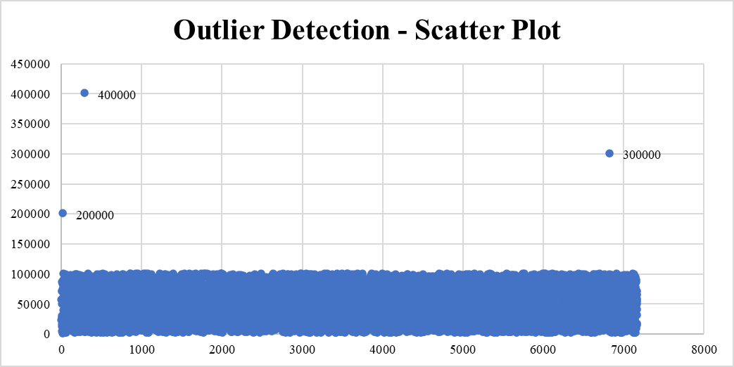
3. Handling Outliers:
While considering the Offered Salary column, there wee 3 outliers 200000, 300000, and 400000 as determined from the Scatter Plot.
These 3 values : 200000, 300000 and 400000 were replaced by the values 45039, 57870 and 46134 obtained by taking the median corresponding to the Department and Post Name.

Slide 8
DATA ANALYTICS TASKS
The hiring process involves bringing new individuals into the organization for various roles.
Task: Determine the gender distribution of hires. How many males and females have been hired by the company?
Hiring Analysis
The average salary is calculated by adding up the salaries of a group of employees and then dividing the total by the number of employees.
Task: What is the average salary offered by this company? Use Excel functions for calculation.
Salary Analysis
Class intervals represent ranges of values, in this case, salary ranges. The class interval is the difference between the upper and lower limits of a class.
Task: Create class intervals for the salaries in the company. This will help you understand the salary distribution.
Salary Distribution

Slide 9
DATA ANALYTICS TASKS
Visualizing data through charts and plots is a crucial part of data analysis.
Task: Use a pie chart, bar graph, or any other suitable visualization to show the proportion of people working in different departments.
Departmental Analysis
Different positions within a company often have different tiers or levels.
Task: Use a chart or graph to represent the different position tiers within the company. This will help you understand the distribution of positions across different tiers.
Position Tier Analysis

Slide 10
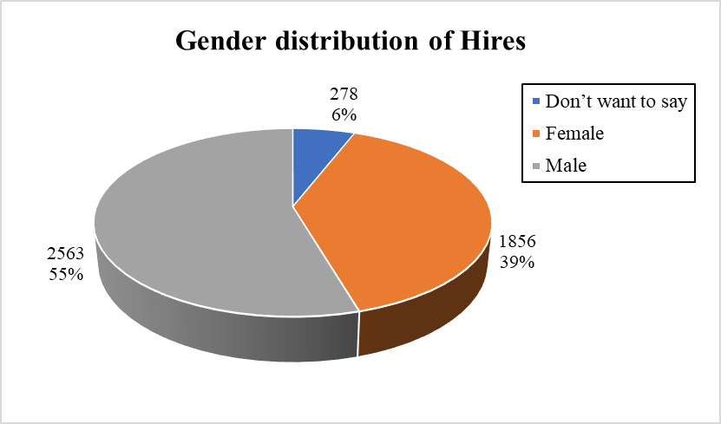

HIRING ANALYSIS
Insights:
- From this analysis, we can understand that more than half of the employees hired are males, contributing 55% whereas the hired female population is about 39%.
- About 6% of the total hired employees have not disclosed their gender.
- This analysis helps the company to keep their focus more on maintaining gender equality by hiring accordingly so that their Gender ratio remains intact for an ideal workplace.

Slide 11
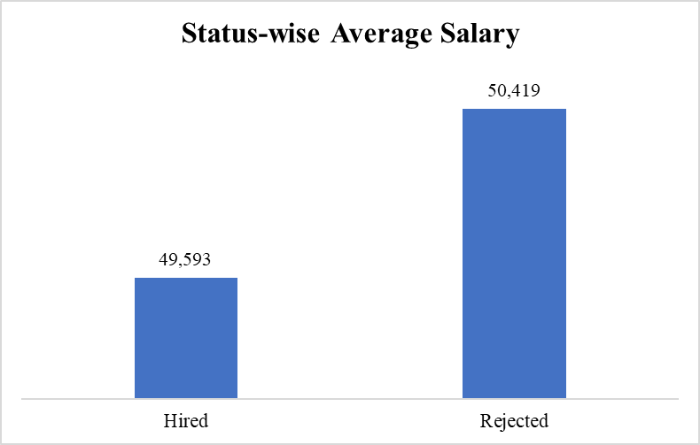
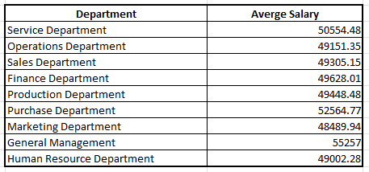
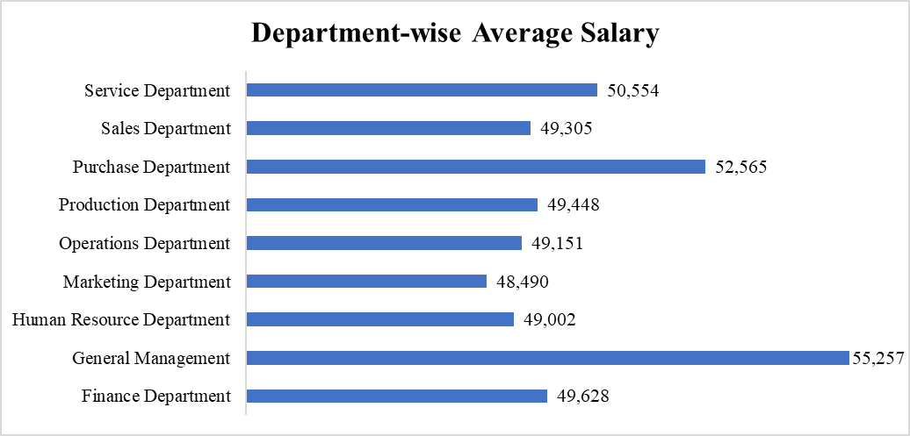

SALARY ANALYSIS
Insights:
- The Average salary for hired candidates is found to be currency unit 49593.02.
- The department having the highest Average salary is “General Management”.

Slide 12
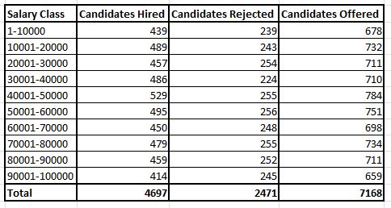
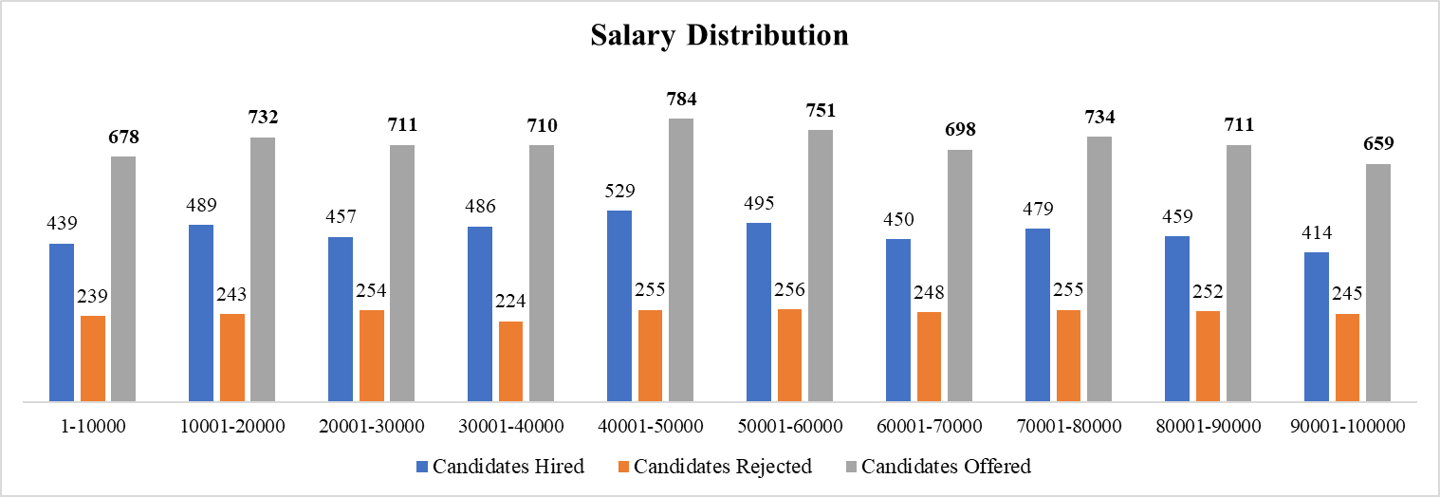
SALARY DISTRIBUTION
Insights:
- Most of the employees are receiving salary in the range 40001-50000, 500001-60000 which corresponds to average salary given to the hired candidates by the company.
- Almost there is an equal distribution of employees from fresher to mid -senior to senior levels.

Slide 13
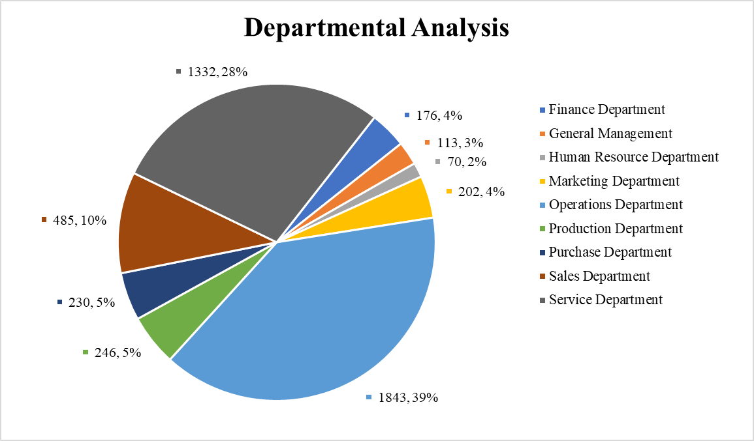
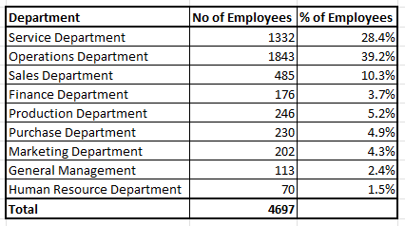
DEPARTMENTAL ANALYSIS
Insights:
- Operations Department has the highest number of employees 1843 in number contributing 39.2% of the total employees followed by Service Department contributing 28.4% with 1332 employees.
- Least number of employees are present in the Human Resource Department with 70 employees.

Slide 14
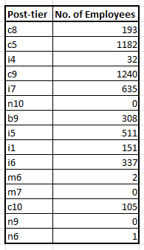
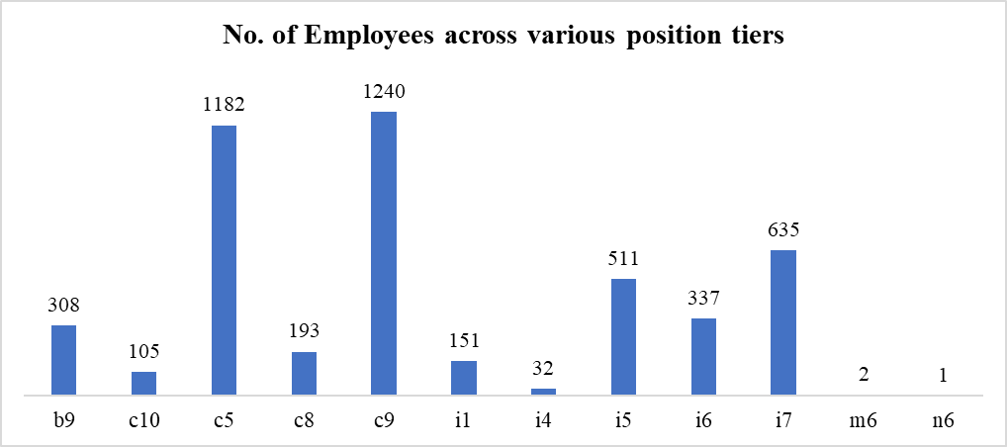
POSITION TIER ANALYSIS
Insights:
- We can observe that the Company has hired most candidates for c9 post-tier followed by c5 and i7.
- Least number of employees are hired for n6 and m6.
- There are no employees hired for n10, m7 and n9 post tiers.

Slide 15
CONCLUSION
The Hiring Process Analytics project have helped in understanding the concept of Exploratory Data Analysis and pivot tables along with using some of functions in MS Excel.
By understanding more on the insights gained from this analysis such as hiring patterns, salary distribution and department-wise composition , the company can focus more the strategies to be taken during the recruitment process and also in promoting organizational growth.

